Slide 1
What You Should Know: An Introduction for Cooperative Board Members
Communication Tips for a Good Board Meeting and Beyond

Slide 2
What is the job of the board?
Protect the interests of both members and the cooperative
Set policy
Assess performance
Preserve the co-op’s character and be a steward of its assets
Build an influential team, capable of differing with management when necessary
Represent and communicate with members
Monitor and oversee management (ask questions about “how” at the tactical level; take actions at the strategic level)
Notes:
We saw this list of responsibilities in the first webinar. Today, we are going to discuss the two middle bullet points that address how you communicate with each other, and with other members.

Slide 3
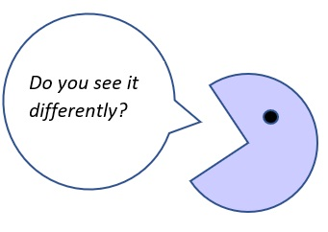
Some good basic communication practices . . .
Start with a shared purpose -- everyone wants the best for the co-op
Assume good intentions – everyone wants what is best for the co-op
Ask questions – seek to better understand someone else’s point of view “Do you see things differently?” “Could you help me understand?”
Try “Yes, And” instead of “Either/Or”
Be clear and succinct when you do speak
Pay attention, be present, use Active Listening
Notes:
Practicing some good basic communication skills will help you in the board room, and also in other aspects of your life – after all, people are everywhere!
Active listening is listen twice as much as you speak, don’t interrupt and reflect back what you heard to make sure you understand

Slide 4
Some good basic communication practices . . .
Ask questions for clarification
Lead with facts, not assumptions
Speak your own truth, but don’t assume it’s the same as someone else’s
If you must disagree, disagree with the idea, not the person
Bring a solution (or at least an idea), don’t just point out a problem
No gossip!--bring discussion to the right place in the board room
Notes:
Ask questions for clarification “I’m curious how the admin team came up with the mileage reimbursement number -- it doesn’t seem intuitive to me, but I maybe don’t have access to all the information. Please help me understand your thinking .. “
(don’t say “everyone thinks this is a bad idea” voice your own opinion. Don’t say “you think . . .or you always . . . “ instead speak your own experience
Not we lost a big customer, we as well go out of business instead “that customer loss will be a big hit to revenue - -can we spend some timing brainstorming about what we can do to fill the hole in the schedule? For example, I was thinking we could . . . “

Slide 5
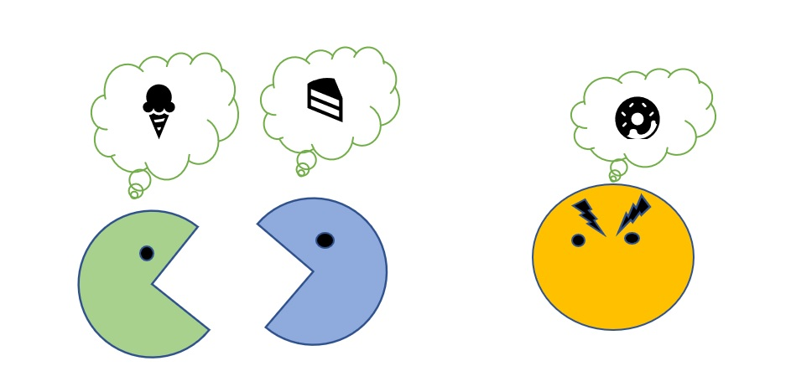
The goal is to be able to disagree, without being disagreeable!
Notes:
A disagreement is healthy! It’s a sign of differences of opinion. A thriving cooperative business needs creative options.

Slide 6
Re-Framing the issue can make a big difference . .
Old problem
Reframed problem
They are the problem
It’s a problem
We don’t have enough money
We don’t have enough time to do all of these things
We don’t have any power in this system
Its all of us who are involved
Its an opportunity
We haven’t figured out how to find new sources of money
We have to decide what to do now, and what to do later
We haven’t found our leverage points in this system
Notes:
Ask your self: what are my goals? Is there an issue we are avoiding? How well do we all understand the issue? What is the source of conflict? How might I frame the discussion in such a way as to build trust and make change?

Slide 7
Some particularly important practices for co-op boards . . . .
Voting, while a well-respected democratic practice,
by its nature can create winners and losers.
Hear out different opinions, and see if you can’t find some
common ground on contentious issues before taking a vote.
Voting does not replace dialogue:
Choose which issues to spend time on in your board meetings, and spend the time necessary to collect information and come to the best decision for the co-op and its members.
Notes:
The first one is not the same as being held hostage to an outlying opinion – just hear them out and see if there isn’t some common ground. But remember, you represent all of the members, not just unhappy ones.

Slide 8
Some particularly important practices for co-op boards . . . .
Make sure every board member
understands that any discussion should
happen out in the open in the board room,
and as a group.
AND . . .
You can have a robust discussion in
Private, but always support each other in
public.
“Speak with one voice”
Notes:
Pre-meetings, side deals, meetings in the parking lot etc. create distrust, sap the energy and efficiency of the board and are really disloyal to the spirit of a shared endeavor. The board needs to work together as a group, and such behavior undermines the trust and mutual respect needed for a cooperative to function.

Slide 9
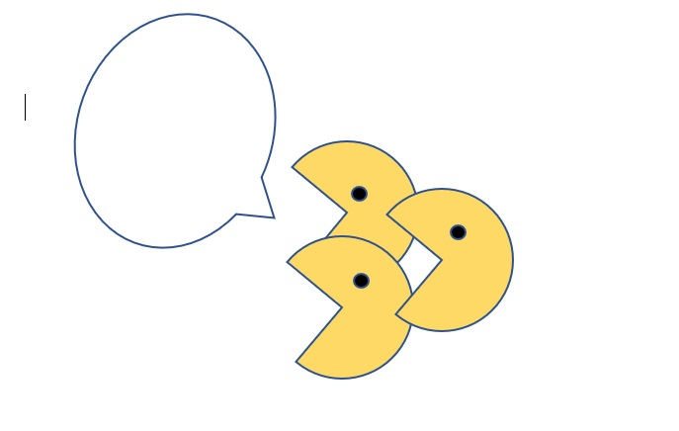
“Speak with One Voice”
What does this mean?
Notes:
“Speak with one voice is probably the most important communication rule that a board member needs to remember. What does this mean? It means that while a board can have, and even encourage rigorous debate within the board room, once a decision has been made, it is a decision of the board. This means that every board member needs to own the decision, even if it wasn’t their choice.
Disagree (respectfully!) in private, support each other in public
I usually frame “speaking with voice” as sharing divergent viewpoints during the decision making process, but speaking with one voice once the board has made a final decision.

Slide 10
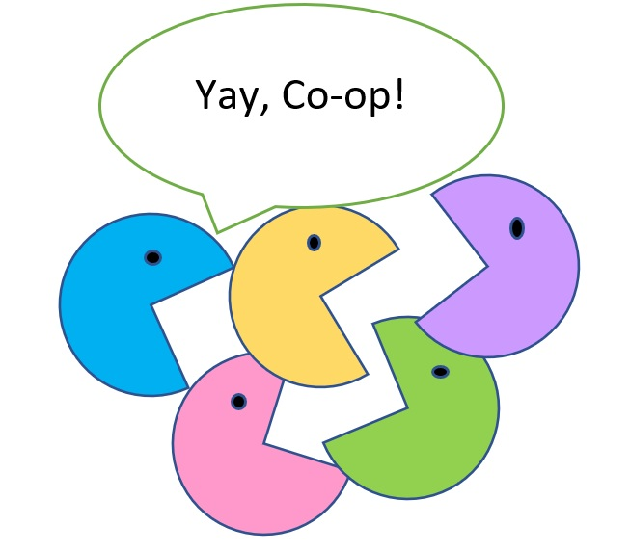
How can our cooperative get better at communication?
Practice!
Get Help
Use your tools like the
agenda to help guide your
discussion
Notes:
Start practicing good communication tools with smaller issues
It often really helps to have an outside board facilitator to help you when you struggle to re-frame issues in a positive light, or just get through your agenda in a timely way
Remember – do not use the agenda as a weapon – “we are done talking now!” but instead as a tool “We have reached the end of our allotted discussion time on this issue - -would we like to take a few minutes from another agenda item, or table this issue until a later date?”

Slide 11
The PHI “Coaching Approach” to leadership:
Active Listening
Self-management and Self-reflection
Clear, non-judgmental communication
Collaborative problem-solving
Participative leadership
https://phinational.org/service/phi-coaching-approach/
Notes:
The Coaching Approach to leadership is a specific framework of respectful communications that is used extensively at Cooperative Home Care Associates in the Bronx. It was developed by PHI specifically in a homecare setting to help members and managers to shed some of their old habits from working in other types of organizations, and communicate with each other in a way that is more respectful and appropriate for a worker-owned business.
Not enough time to go into in full here, but you can see more about it on the website.

Slide 12
Tools of the Board
Agendas
Budgets and financial reports
Board calendar
Committee reports and other information
Board self-evaluations
Management performance reviews
Strategic planning retreats
Board training and development plan
Board facilitators or other helpers/advisors

Slide 13
Your board tools can help . .
Agendas with time allocations help you from getting off topic
Clear financial reports and metrics help build a shared understanding of a situation
Annual self-evaluations of the board and performance evaluations of management encourage productive conversations and identify opportunities for skill-building
Regularly re-committing to a shared vision and mission builds alignment and shared purpose
A commitment to honesty and transparency builds mutual respect and trust

Slide 14
Thank you!
Content provided by UW Center for Cooperatives, Northwest Cooperative Development Center, USDA, Co-opera Company , Paraprofessional Healthcare Institute, Sam Kaner “A facilitator’s guide to participative decision-making”

